Slide 1




NEXT GEN EMPLOYABILITY PROGRAM
Creating a future-ready workforce
Team Members
College Name
Student Name :S.PAVITHRA
Student ID :511321104066
Kingston engineering college

Slide 2

CAPSTONE PROJECT SHOWCASE
Project Title
Building Bus Reservation System using Python and Django
Abstract | Problem Statement | Project Overview | Proposed Solution | Technology Used | Modelling & Results | Conclusion

Slide 3
Abstract
This project aims to develop a bus reservation system using full-stack web development technologies, specifically Python and Django. The system will allow users to search for buses based on their preferred routes and schedules, view seat availability, and make reservations online.
On the frontend, the project will utilize HTML, CSS, and JavaScript to create a user-friendly interface. The backend will be powered by Django, a high-level Python web framework, to handle data processing, user authentication, and business logic.
The bus reservation system will include features such as user registration and login, searching for available buses, selecting seats, making reservations, and viewing booking history. The system will also include an admin interface to manage buses, routes, and reservations.
Overall, this project aims to showcase the capabilities of Python and Django in developing robust and scalable web applications for the transportation industry.
Source :

Slide 4
Problem Statement
This project aims to create a user-friendly bus reservation system using Python and Django. The current bus booking systems are often complex and lack modern features. This project seeks to address these issues by designing a system that allows users to easily search for buses, select seats, and make reservations online. It will also provide bus operators with tools to manage their buses, routes, and reservations efficiently. The key challenges include designing an intuitive user interface, tracking seat availability in real-time, integrating payment gateways, implementing user authentication, and ensuring system performance under high user loads. By overcoming these challenges, the project aims to improve the booking experience for passengers and enhance the operational efficiency of bus operators.
Source :

Slide 5
Project Overview
The goal of this project is to develop a bus reservation system using full-stack web development technologies, specifically Python and Django. The system will allow users to search for buses based on their preferred routes and schedules, view seat availability, and make reservations online. It will also provide bus operators with tools to manage buses, routes, and reservations efficiently.
The frontend of the application will be built using HTML, CSS, and JavaScript to create a user-friendly interface. The backend will be powered by Django, a high-level Python web framework, to handle data processing, user authentication, and business logic.
Key features of the bus reservation system will include user registration and login, searching for available buses, selecting seats, making reservations, and viewing booking history. The system will also include an admin interface for bus operators to manage buses, routes, and reservations.
Overall, this project aims to demonstrate the capabilities of Python and Django in developing robust and scalable web applications for the transportation industry. It will provide a modern and efficient bus reservation system that enhances the booking experience for passengers and improves the operational efficiency of bus operators.
Source :

Slide 6
Proposed Solution
.
The proposed solution is to build a bus reservation system using Python and Django. This system will have two main parts: a user interface for passengers and an admin interface for bus operators. Passengers will be able to search for buses, select seats, and make reservations easily. Bus operators will be able to manage buses, routes, and reservations efficiently. The system will also include features like user authentication, real-time seat availability tracking, online payment integration, and booking history management. Overall, this solution aims to create a user-friendly and effective bus reservation system for both passengers and bus operators.
Frontend Development: The frontend of the application will be developed using HTML, CSS, and JavaScript to create a responsive and intuitive user interface. The frontend will allow users to search for buses based on their desired routes and schedules, view seat availability, select seats, and make reservations.
Backend Development: The backend of the application will be powered by Django, a high-level Python web framework. Django will be used to handle data processing, user authentication, and business logic. The backend will also include a database to store information about buses, routes, seat availability, reservations, and user data.
Source :

Slide 7
1. User Interface (UI): The user interface will be designed to be intuitive and user-friendly. Passengers will be able to search for buses by entering their desired route and date. The system will display a list of available buses along with their schedules and seat availability. Passengers can then select their preferred bus and seats, and proceed to make a reservation.
2. Admin Interface: The admin interface will allow bus operators to manage buses, routes, and reservations. Bus operators will be able to add new buses, define routes, set schedules, and manage seat availability. They will also be able to view and manage reservations, including modifying or canceling existing bookings.
3. User Authentication: The system will include user authentication to ensure that only authorized users can access certain features, such as making reservations or managing buses. Users will be required to sign up and log in to access these features.
4. Real-time Seat Availability: The system will track seat availability in real-time to prevent overbooking. When a passenger selects a seat, the system will update the seat availability status immediately to ensure that seats are not double-booked.
Source :

Slide 8
5. Payment Integration: The system will integrate with payment gateways to allow passengers to make secure online payments for their reservations. Passengers will be able to pay using credit/debit cards, net banking, or other online payment methods.
6. Booking History: Passengers will have access to their booking history, which will show details of their past reservations. They will also be able to manage their reservations, including modifying or canceling existing bookings.
7. Scalability and Performance: The system will be designed to be scalable and performant, capable of handling a large number of users and transactions simultaneously. It will be optimized for speed and efficiency to provide a seamless booking experience for passengers.
Conclusion:
The proposed solution aims to create a comprehensive bus reservation system using Python and Django. By providing a user-friendly interface for passengers and an efficient management interface for bus operators, the system will enhance the booking experience for passengers and improve the operational efficiency of bus operators.
Source :

Slide 9

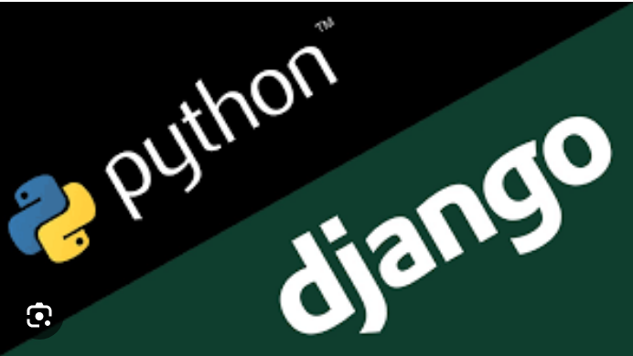
Technology Used
Front-end
Back-end
Source :

Slide 10
Modelling & Results
In the bus reservation system developed using Python and Django, the data is structured into different categories like buses, routes, schedules, seats, and reservations. Each bus has specific attributes such as its number, capacity, and type, while routes have details like origin, destination, and distance. Schedules include departure and arrival times for buses on specific routes. Seats are identified by seat numbers and have availability statuses. Reservations are linked to passengers and contain details like passenger names and contact numbers along with the reserved seat numbers. This structured approach allows for efficient management of bus operations and bookings.
Source :

Slide 11
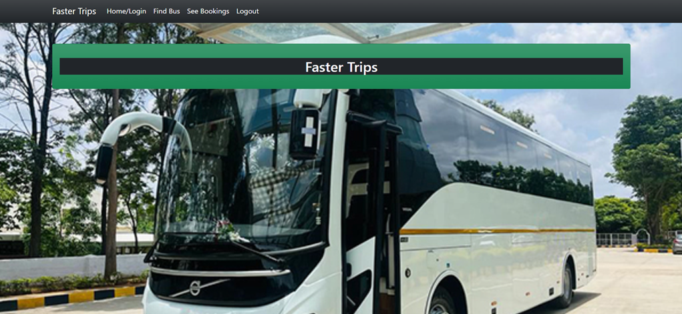
Homepage

Slide 12
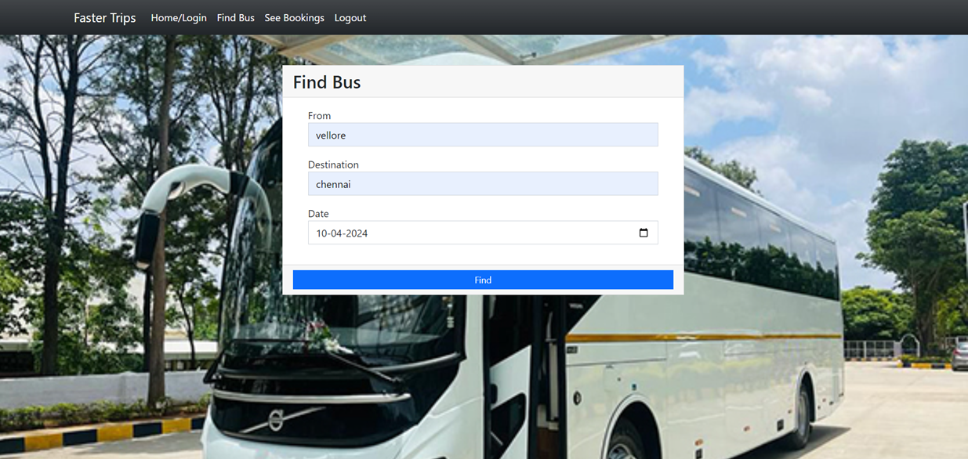
Service-Page

Slide 13
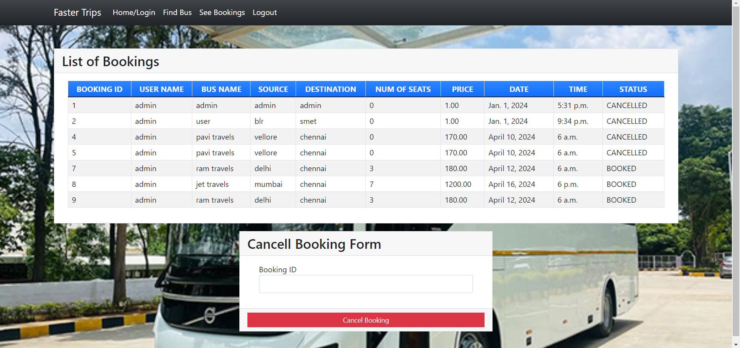
Departments-Page

Slide 14
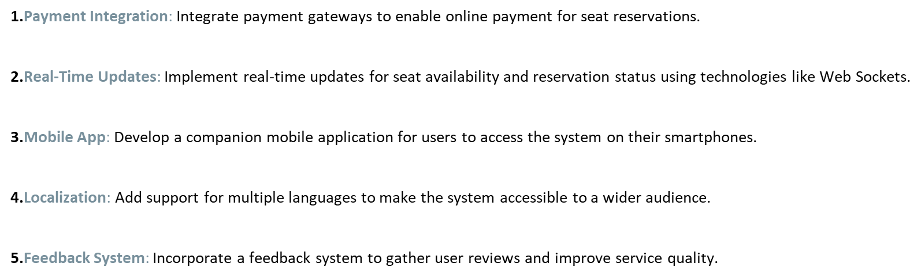
Future Enhancements:

Slide 15
Conclusion
In conclusion, developing a bus reservation system using Python and Django for full-stack web development offers a robust and efficient solution for managing bus operations and bookings. The system provides a user-friendly interface for passengers to search for buses, select seats, and make reservations, while also offering bus operators tools to manage buses, routes, and reservations effectively. Features such as user authentication, real-time seat availability tracking, payment integration, and booking history management enhance the overall user experience. Additionally, the scalability and performance of the system ensure that it can handle a large number of users and transactions. Overall, Python and Django prove to be powerful tools for developing a modern and efficient bus reservation system.
Source :

Slide 16
Thank You!
Notes:
Thank You !!

